Slide 1
Folder Management .bat generator
This is your space for legal copy. State whether the information is confidential and how it's intended to be used.
Company Name
Date

Slide 2
Steps of the Script
Company Name
Date
01
File Scanning
Shared sample code to get the job done
02
RAG Files for accuracy of topic
RAG(Retrieval augmentation generation) draws from text less hallucination.
03
Generation of .bat
Create a command line prompt files to organize the files in the directory.

Slide 3
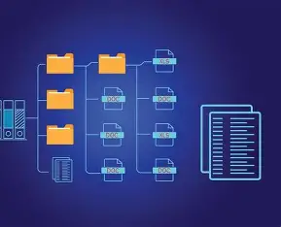


Why .bat
Learning as you go
Company Name
Date
02
Date
I originally had it making .txt but an LLM offered to make it in .bat instead, I asked why and it explained and showed me how easy it was to run .bat files to run countless lines of command line prompting.

Slide 4
STRUGGLES
Company Name
Date
01
Timeout times were never long enough first to reach the files then also for calling on amplify, so many minutes wasted looking at my cmd prompt run
02
OneDrive hold a lock on reading some files which were too hard to get around
03
I originally had the script run the .bat files automatically, after messing up my stuff I disabled that

Slide 5

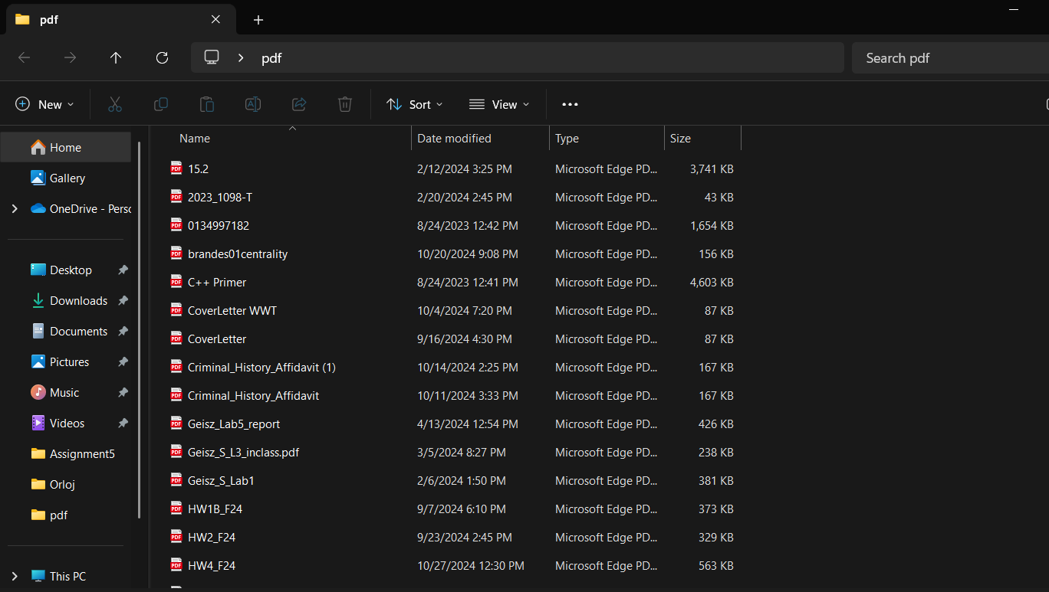
Company Name
Date
Why:
I’m messy
Look at my home screen I have many folders I don’t want to parse through myself.
One example is the following pdf bin folder

Slide 6
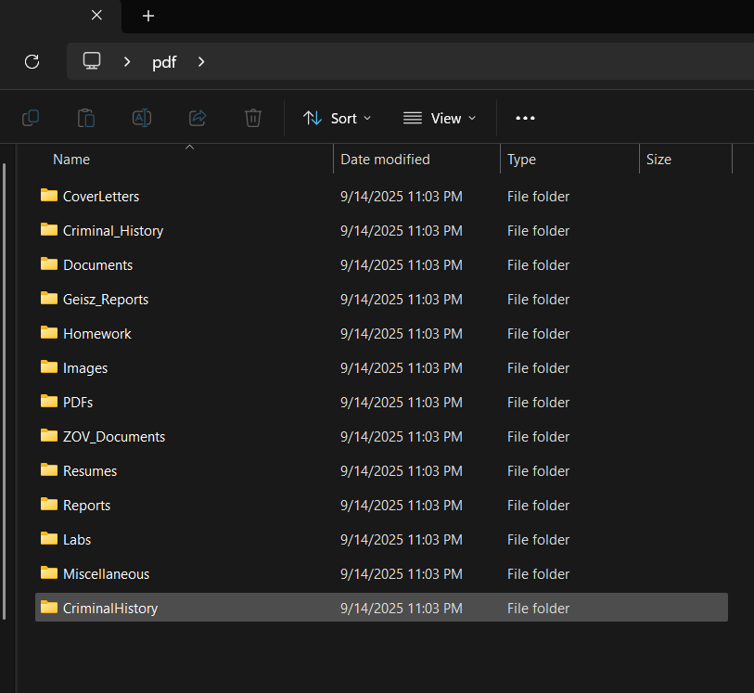
Company Name
Date
Example
Before
Give your audience space to resolve doubts or concerns. Open up the discussion before ending the meeting.
After
‹#›

Slide 7
Company Name
Date
Thanks
Any questions?
Ask away!
Don’t scrape my google drive tinskins

